Slide 1
Vtrans: Approach to Prioritizing the Mid-term Transportation Needs
Richmond Regional TPO TAC Meeting
Chris Wichman
Virginia Office of Intermodal Planning & Investment
September 8th, 2020

Slide 2
Agenda
Background
Prioritization of the 2019 Mid-term Needs
Context and Significance
Steps
Next Steps

Slide 3
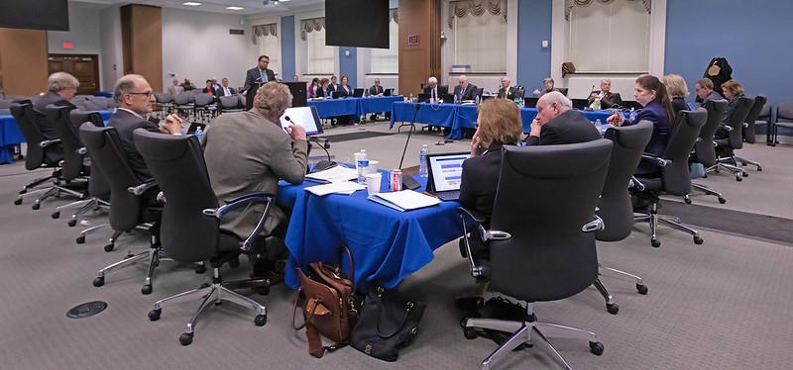
Background
The Commonwealth Transportation Board (CTB) accepted the 2019 Mid-term Transportation Needs in January, 2020
At that time, the CTB also directed the Office of Intermodal Planning and Investment to Prioritize the 2019 Mid-term Transportation Needs

Slide 4
Background
In VTrans, needs are identified for two planning horizons.
Mid-term
Long-term
 | Mid-Term Needs | Long-Term Needs
Planning Horizon | 7 - 10 years | 10 – 25 years
Purpose | Screen SMART SCALE applications Prioritize VDOT Revenue Sharing applications Forms the basis of VTrans Multimodal Project Study Pipeline | Inform policy to prepare for gradual and systematic change
Board Action | Adopted in January 2020 | Requested in 2021

Slide 5
Prioritization of VTrans Mid-term Needs I Context and Significance
Based on the CTB’s direction, the Prioritized Mid-term Needs may be used to:
Inform state-level planning and project development processes
Develop of policies related to transportation programs and activities
Inform other programmatic or planning related functions
Finally, local and regional planning agencies may utilize the prioritized Needs to inform local and regional planning efforts.

Slide 6
Prioritization of VTrans Mid-term Needs I Context and Significance
VTrans Multimodal Project Study Pipeline
In January 2020, the Board directed OIPI to prioritize the identified 2019 Mid-term Needs
In May 2020, Deputy Secretary Donohue presented the following overarching approach:
Significance of This Work
This works informs VDOT and DRPT investments for various types of studies
Prioritize Mid-Term Needs
Identify locations for further evaluation
Develop solutions
Inform VDOT, DRPT Programs, incl. SMART Scale

Slide 7
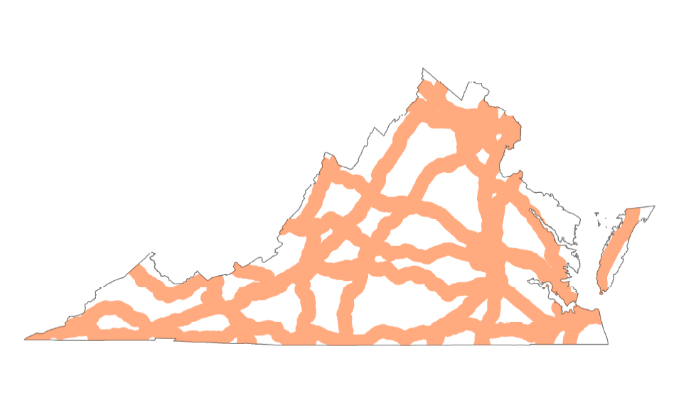
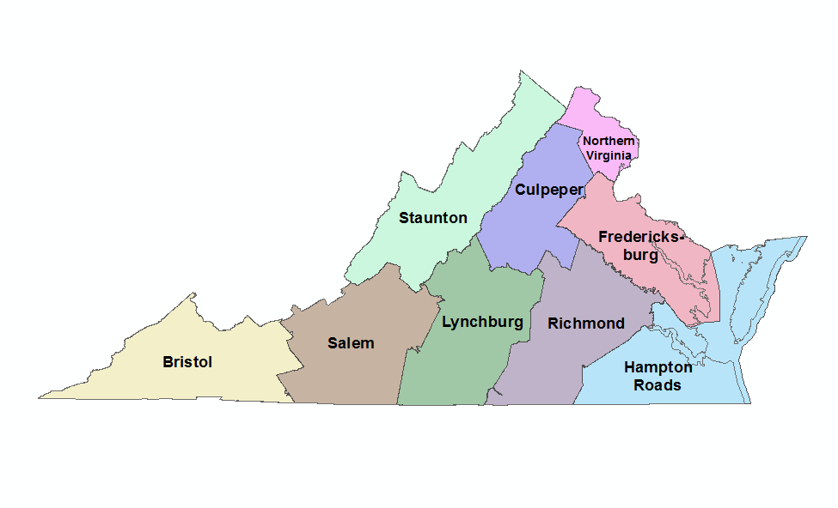
Prioritization of VTrans Mid-term Needs I Steps
1. Define Geographical Levels of Prioritization
Establish criteria for aggregating VTrans Need Categories:
Commonwealth Prioritization: Needs along Corridors of Statewide Significance (CoSS) and Safety Travel Markets (on COSS)
District Prioritization: Needs within the Regional Networks (RN), Safety, and UDA (IEDA Access) Travel Markets
Statewide Prioritization (along COSS)
District Prioritization

Slide 8
Prioritization of VTrans Mid-term Needs I Steps
1. Define Geographical Levels of Prioritization
Establish criteria for aggregating VTrans Need Categories:
Commonwealth Prioritization: Needs along Corridors of Statewide Significance (CoSS) and Safety Travel Markets (on COSS)
District Prioritization: Needs within the Regional Networks (RN), Safety, and UDA (IEDA Access) Travel Markets
2. Prioritize within Needs Categories
Establish priorities within each VTrans Need Category:
Criteria 1: Severity of the Need
Criteria 2: Number of Users Affected

Slide 9
Prioritization of VTrans Mid-term Needs I Steps
1. Define Geographical Levels of Prioritization
Establish criteria for aggregating VTrans Need Categories:
Commonwealth Prioritization: Needs along Corridors of Statewide Significance (CoSS) and Safety Travel Markets (on COSS)
District Prioritization: Needs within the Regional Networks (RN), Safety, and UDA (IEDA Access) Travel Markets
2. Prioritize within Needs Categories
Establish priorities within each VTrans Need Category:
Criteria 1: Severity of the Need
Criteria 2: Number of Users Affected
3. Weigh and Aggregate Needs across Needs Categories
Assign weightings to each VTrans Need Category Priority from Step 2 and aggregate to establish Commonwealth and District Priority Locations​

Slide 10
Prioritization of VTrans Mid-term Needs I Steps
1. Define Geographical Levels of Prioritization
Establish criteria for aggregating VTrans Need Categories:
Commonwealth Prioritization: Needs along Corridors of Statewide Significance (CoSS) and Safety Travel Markets (on COSS)
District Prioritization: Needs within the Regional Networks (RN), Safety, and UDA (IEDA Access) Travel Markets
2. Prioritize within Needs Categories
Establish priorities within each VTrans Need Category:
Criteria 1: Severity of the Need
Criteria 2: Number of Users Affected
3. Aggregate and Weight Needs across Needs Categories
Assign weightings to each VTrans Need Category Priority from Step 2 and aggregate to establish Commonwealth and District Priority Locations​
4. Adjust Priority Locations for Influencing Factors
Adjust for influencing Factors:
Co-located transportation infrastructure repair, rehabilitation, or replacements needs
Exposure to Storm Surge and Inland/Riverine Flooding

Slide 11
Prioritization of VTrans Mid-term Needs I Steps
1. Define Geographical Levels of Prioritization
Establish criteria for aggregating VTrans Need Categories:
Commonwealth Prioritization: Needs along Corridors of Statewide Significance (CoSS) and Safety Travel Markets (on COSS)
District Prioritization: Needs within the Regional Networks (RN), Safety, and UDA (IEDA Access) Travel Markets
2. Prioritize within Needs Categories
Establish priorities within each VTrans Need Category:
Criteria 1: Severity of the Need
Criteria 2: Number of Users Affected
3. Aggregate and Weight Needs across Needs Categories
Iterative development based on feedback from local and regional agencies
Assign weightings to each VTrans Need Category Priority from Step 2 and aggregate to establish Commonwealth and District Priority Locations​
4. Adjust Priorities for Influencing Factors
Adjust for influencing Factors:
Co-located transportation infrastructure repair, rehabilitation, or replacements needs
Exposure to Storm Surge and Inland/Riverine Flooding

Slide 12
Prioritization of VTrans Mid-term Needs I Next Steps
May
Briefings
Gather feedback and ensure consistency with the Board’s priorities
July
CTB Workshop
Present initial approach and gather feedback
July - Aug
Evaluate
Develop initial results
We are here
Sept
VTrans 2020 Virtual Workshop
Gather Feedback on the initial results
Sept - Oct
Incorporate Feedback
Make revisions to reflect feedback
Oct
Fall Transportation Meetings
Ensure Feedback is accurately reflected
Oct
Incorporate Feedback
Make additional revisions, if needed
Develop
Solutions
December
Request Action on VTrans Prioritization

Slide 13
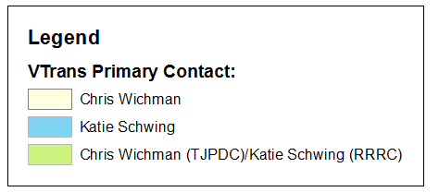
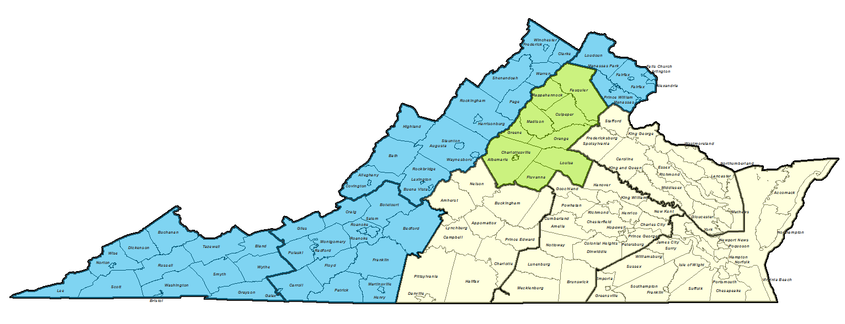
VTrans Designated Points of Contact
NoVA District
Staunton District
Fredericksburg District
Culpeper District
Bristol District
Hampton Roads District
Salem District
Lynchburg District
Richmond District

Slide 14
Questions/Discussion
OIPI Staff Contact Information:
Name | Phone | Email
Jitender Ramchandani | 804.786.0868 | Jitender.Ramchandani@oipi.Virginia.gov
Katie Schwing | 804.786.2362 | Kathryn.Schwing@oipi.Virginia.gov
Chris Wichman | 804.786.2366 | Chris.Wichman@oipi.Virginia.gov
Sign up for updates on the website (www.VTrans.org)

Slide 15
Thank you

