Slide 1
Drugs Affecting the RVA Region
Senior Special Agent Brian C. Moore
Virginia State Police
Bureau of Criminal Investigation
Drug Enforcement Section - Richmond

Slide 2
Who Am I?
Senior Special Agent Brian C. Moore
May 10, 2000 – Present
Trooper: 2000 – 2006
Sussex and Surry Counties
K-9 handler 2002 – 2006
Special Agent: November 2006 – Present
Chesapeake (Division 5): 2006 – August 2013
Richmond (Division 1): August 2013 - present

Slide 3
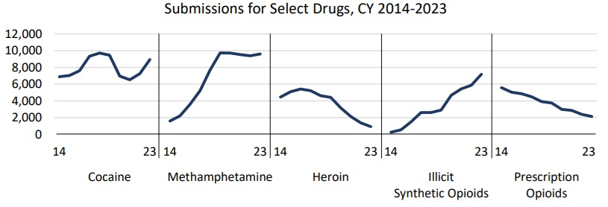
Availability of Drugs in Virginia (2023)
Most common substances identified:
Methamphetamine
Cocaine
Fentanyl (Illicit Synthetic Opioids)

Slide 4
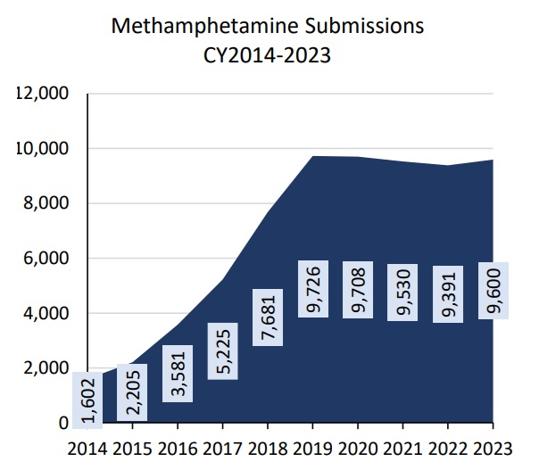
Methamphetamine in Virginia (10 years)
Methamphetamine
Most submissions to DFS in 2023
23% of ALL drug submissions to DFS
Prior to 2016ish
One pot meth
Estimated 30% pure
Around $100 for a gram
2016 – present
Crystal meth saturated the market
98-100% pure
$1,600 - $4,000 for 1 POUND
Average in this area is $2,000/lb

Slide 5
Methamphetamine REGIONALLY (2013)

Slide 6
Methamphetamine REGIONALLY (2018)

Slide 7
Methamphetamine REGIONALLY (2023)

Slide 8
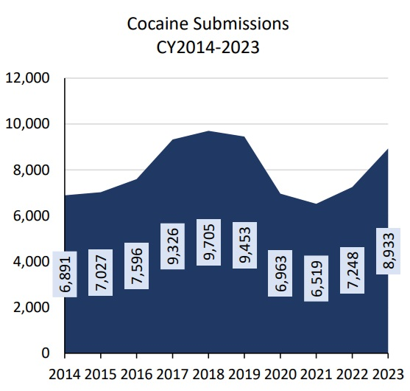
Cocaine in VIRGINIA (10 years)
Cocaine
High submission rate to DFS in 2023
22% of ALL drug submissions to DFS
Trends
2018 = highest year
Trending down
2021 = starting to trend back up
2023 = nearing 2018-19 numbers

Slide 9
Cocaine REGIONALLY (2013)

Slide 10
Cocaine REGIONALLY (2018)

Slide 11
Cocaine REGIONALLY (2023)

Slide 12
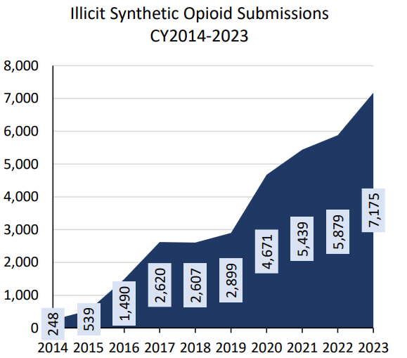
Illicit Synthetic Opioids in VIRGINIA (10 Years)
Most frequently submitted in opioid drug category
Surpassed heroin AND prescription opioids
18% of all drug submissions to DFS
Most common in this category is Fentanyl
Fentanyl is used as a mixing agent for most drugs
Mixing Xylazine with Fentanyl
Xylazine is becoming more popular

Slide 13
Illicit Synthetic Opioids REGIONALLY (2013)

Slide 14
Illicit Synthetic Opioids REGIONALLY (2018)

Slide 15
Illicit Synthetic Opioids REGIONALLY (2023)

Slide 16
Key “take home” points:
Just one can kill
Fentanyl is in EVERYTHING
What you think you are buying may NOT be what your are buying
Naloxne (Narcan) saves lives
Where (or do) you provide access to it?
The “war on drugs” is won ONE person at a time
If you see something, say something
Drug addiction does not discriminate
Personalize the battle

Slide 17
All drug overdose rates Q1-Q2 (2024)

Slide 18
Questions?
Senior Special Agent Brian C. Moore
brian.moore@vsp.virginia.gov
(804) 385-0808

