Slide 1


Commissioner Orientation
February 8, 2024

Slide 2
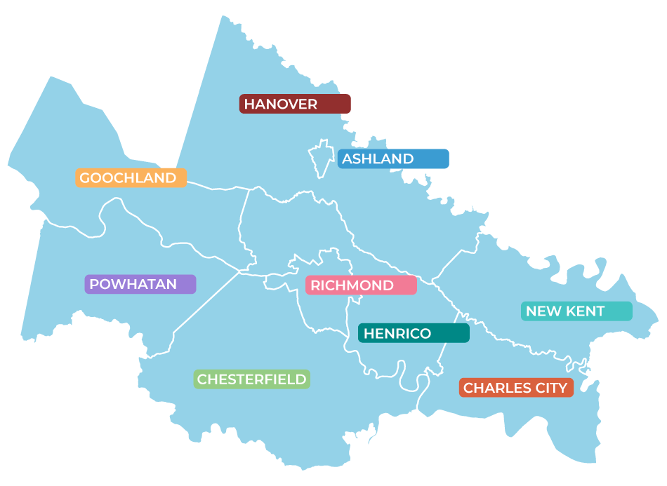
Who We Are
Established in 1969, PlanRVA has been the home of cooperation among the nine jurisdictions of Central Virginia for more than 50 years. ​
PlanRVA is where the region comes together to look ahead.
Notes:
PlanRVA is an organization established in 1969 by the nine localities of Central Virginia. It is authorized under the Regional Cooperation Act of 1974, as amended, and aims to promote regional cooperation and support coordination among its member jurisdictions on issues of regional significance. As a regional convenor and technical assistance provider, PlanRVA has the power to support localities of the Richmond Region in their cooperative endeavors to make Central Virginia the best it can be.
§ 15.2-4207. Purposes of commissionA. It is the purpose of the planning district commission to encourage and facilitate local government cooperation and state-local cooperation in addressing on a regional basis problems of greater than local significance. The cooperation resulting from this chapter is intended to facilitate the recognition and analysis of regional opportunities and take account of regional influences in planning and implementing public policies and services. Functional areas warranting regional cooperation may include, but shall not be limited to: (i) economic and physical infrastructure development; (ii) solid waste, water supply and other environmental management; (iii) transportation; (iv) criminal justice; (v) emergency management; (vi) human services; and (vii) recreation.
Types of regional cooperative arrangements that commissions may pursue include but are not limited to (i) the facilitation of revenue sharing agreements; (ii) joint service delivery approaches; (iii) joint government purchasing of goods and services; (iv) regional data bases; and (v) regional plans.
B. The planning district commission shall also promote the orderly and efficient development of the physical, social and economic elements of the district by planning, and encouraging and assisting localities to plan, for the future. If requested by a member locality or group of member localities and to the extent the commission may elect to act, the commission may assist the localities by carrying out plans and programs for the improvement and utilization of their physical, social and economic elements. The commission shall not, however, have a legal obligation to perform the functions necessary to implement the plans and policies established by it or to furnish governmental services to the district. Additionally, Planning District Commissions 1, 2, and 13 shall be designated as economic development organizations within the Commonwealth.
C. The authority of the commission includes the power, to the extent the commission may from time to time determine, when requested to do so by a member locality or group of member localities, (i) to participate in the creation or organization of nonprofit corporations to perform functions or operate programs in furtherance of the purposes of this chapter; (ii) to perform such functions and to operate such programs itself; (iii) to contract with nonprofit entities, including localities, performing such functions or operating such programs to provide administrative, management, and staff support, accommodations in its offices, and financial assistance; and (iv) to provide financial assistance, including matching funds, to interdistrict entities which perform governmental or quasi-governmental functions directly benefiting the commission's district and which are organized under authority of the Commonwealth or of the federal government.
D. Nothing herein shall be construed to permit the commission to perform functions, operate programs, or provide services within and for a locality if the governing body of that jurisdiction opposes its doing so.
2

Slide 3
Regional Cooperation Act
Enabling legislation for planning district commissions
Establishes 12 general duties of PDCs, including regional planning, technical assistance, regional coordination
PDCs required to have a regional strategic plan to guide the district on matters that are of importance to more than one locality. Subject to public review and performance indicators.
Required to report on strategic plan to DHCD annually: Status of the Plan and its Implementation
Notes:
Contrast how we currently do reg strat plan reporting vs how we can if we center our agency on the reg strat plan

Slide 4
RCA Highlights
§ 15.2-4209. Preparation and adoption of regional strategic plan
  each planning district commission shall prepare a regional strategic plan for the guidance of the district
  The plan shall concern those elements which are of importance in more than one of the localities within the district
  The plan shall include regional goals and objectives, strategies to meet those goals and objectives and mechanisms for measuring progress toward the goals and objectives.
  The strategic plan shall include those subjects necessary to promote the orderly and efficient development of the physical, social and economic elements of the district such as transportation, housing, economic development and environmental management.
  In developing the regional strategic plan, the planning district commission shall seek input from a wide range of organizations in the region, including local governing bodies, the business community and citizen organizations.
Regional Cooperation Act (virginia.gov)
§ 15.2-4207. Purposes of commission
  encourage and facilitate local government cooperation and state-local cooperation in addressing on a regional basis problems of greater than local significance.
  Functional areas warranting regional cooperation may include, but shall not be limited to: (i) economic and physical infrastructure development; (ii) solid waste, water supply and other environmental management; (iii) transportation; (iv) criminal justice; (v) emergency management; (vi) human services; and (vii) recreation.
§ 15.2-4208. General duties of planning district commissions
  12 duties
Notes:
Point out links to PlanRVA brand identity?

Slide 5

Local Technical Assistance
PlanRVA staff are available to support local government in many ways ranging from special events support, grant writing, policy research and analysis, data collection and planning.
    Grant Writing & Administration
    Data, Research & Analysis
    Planning and Project Management
    Public Engagement and Outreach
    Administrative/ Back Office
Notes:
Emergency Management Alliance- State Homeland Security Grant Applications
Infrastructure Bill
Regional Demographics, Local GIS training and support
EMACV
EnvTAC
Regional PIOs and Communicators
Planning Directors
Regional Economic Developers (GO Virginia)
Local Clerks
5

Slide 6

Regional Planning:
How Does It Work?
    Use data to identify future challenges and opportunities
    Convene local governments to facilitate regional collaboration
    Cultivate partnerships and resources to develop innovative solutions
    Draft and implement plans of action
...to ensure the region is a place for all to live, work, play and thrive.
Notes:
15.2-4209. Preparation and adoption of regional strategic plan A. Except in planning districts in which regional planning also is conducted by multi-state councils of government, each planning district commission shall prepare a regional strategic plan for the guidance of the district. The plan shall concern those elements which are of importance in more than one of the localities within the district, as distinguished from matters of only local importance. The plan shall include regional goals and objectives, strategies to meet those goals and objectives and mechanisms for measuring progress toward the goals and objectives. The strategic plan shall include those subjects necessary to promote the orderly and efficient development of the physical, social and economic elements of the district such as transportation, housing, economic development and environmental management. The plan may be divided into parts or sections as the planning district commission deems desirable. In developing the regional strategic plan, the planning district commission shall seek input from a wide range of organizations in the region, including local governing bodies, the business community and citizen organizations.
Vision for our Community: Regional Strategic Plan
- Over-Arching Regional Needs/Objectives
- Strategic Objectives/ Planning Deliverables
- Regional Indicators
- Action Plans for moving the needle
- Performance Evaluation & Best Practices
6

Slide 7
Regional Strategic Plan
Functional Area Element
Defines coordinated regional vision and goals
Indicates the role and responsibilities of PlanRVA in serving the region through implementation
Contextualizes the relationship, content, and processes for functional area plans
Functional Area Element
Core Regional Vision
Functional Area Element
Functional Area Element

Slide 8
What We Do
PlanRVA's experienced planners and experts have been supporting the region's future development in the areas of:
Environment
& Resiliency​
Community Development
Emergency Preparedness & Hazard Mitigation
Transportation
Notes:
PlanRVA is a versatile organization specializing in multiple essential areas, including community development, resilience, emergency management, the environment, and transportation. Our skilled and experienced team provides valuable resources such as grant writing and administration, planning, and project management.
15.2-4208. General duties of planning district commissionsPlanning district commissions shall have the following duties and authority:
1. To conduct studies on issues and problems of regional significance;
2. To identify and study potential opportunities for state and local cost savings and staffing efficiencies through coordinated governmental efforts;
3. To identify mechanisms for the coordination of state and local interests on a regional basis;
4. To implement services upon request of member localities;
5. To provide technical assistance to state government and member localities;
6. To serve as a liaison between localities and state agencies as requested;
7. To review local government aid applications as required by § 15.2-4213 and other state or federal law or regulation;
8. To conduct strategic planning for the region as required by §§ 15.2-4209 through 15.2-4212;
9. To develop regional functional area plans as deemed necessary by the commission or as requested by member localities;
10. To assist state agencies, as requested, in the development of substate plans;
11. To participate in a statewide geographic information system, the Virginia Geographic Information Network, as directed by the Department of Planning and Budget; and
12. To collect and maintain demographic, economic and other data concerning the region and member localities, and act as a state data center affiliate in cooperation with the Virginia Employment Commission.
3

Slide 9
Transportation Element
Housing Element
Economic Development Element
Regional Strategic Vision
Adopted by PlanRVA
Adopted by member localities or agencies
Environment Element
Energy Element
Adopted by other regional entity staffed by PlanRVA
Emergency Management Element
In development or not adopted

Slide 10
Definitions
Plan – Strategic document which lays out goals and objectives, strategies to meet those goals and objectives and mechanisms for measuring progress toward the goals and objectives
Study – independent investigation of issues and problems of regional significance which informs plans
Program – services, technical assistance, and other mechanisms to implement or advance plans
Performance Indicators – Data points or other quantifiable metric of progress towards a goal

Slide 11








Notes:
1.7.2013
Over the years, PlanRVA has been a platform where the region comes together to plan for the future. It has served as a starting point for critical regional conversations that have often resulted in developing new programs or organizations dedicated to serving the region. Some of the Commission's accomplishments include establishing the Central Virginia Waste Management Authority, launching the Central Virginia Transportation Authority, developing the Don't Trash Central Virginia Anti-Litter Messaging campaign, and convening the region’s first Urban Area Security Initiative.
Here are a few examples of our current work that you may already know:
Don't Trash:
Our regional litter prevention messaging program
Plan Safe/EMACV
Offering safety tips to make sure you and your loved ones are prepared for natural disasters.
CVTA:
A regional authority that provides transparent funding opportunities for transportation investments
RRTPO:
The Richmond Regional Transportation Planning Organization (RRTPO) is our transportation planning entity. Their focus is long-range multi-modal investments in the areas of transit, highways, bicycles, pedestrians and freight.
FOLAR:
Cross-regional partnership with Crater District PDC to support trails and our natural resources, like the Appomattox River.
‹#›

Slide 12

What is the CVTA?
Created in 2020 through legislation passed by the General Assembl, the Central Virginia Transportation Authority helps move our region forward by directing priority transportation funding to improve mobility and the quality of life for people living here.
The CVTA focuses on transportation projects across nine jurisdictions: the town of Ashland, the counties of Charles City, Chesterfield, Goochland, Hanover, Henrico, New Kent, Powhatan and the city of Richmond. Member localities and other regional bodies serve on the Authority's Board of Directors and committees.
The CVTA is comprised of the main board (Authority), a Finance Committee, a
Technical Advisory Committee (TAC) and other committees/working groups
as needed.
The CVTA is led by Executive Director, Chet Parsons.

Slide 13
Central Virginia Transportation Authority
  Memorandum of Understanding between PlanRVA and the CVTA providing for:
    Staffing to assist the Authority in its administration, financial management, project evaluation/prioritization, logistics and other planning and technical support.

Slide 14

What is the RRTPO?
  The Richmond Regional Transportation Planning Organization (RRTPO) is the region’s designated Metropolitan Planning Organization and handles transportation planning in the region.
  The RRTPO helps facilitate collaboration and cooperation among all interested parties, including residents, in regard to funding and planning the future of the region’s transportation network.
  The RRTPO is the federally-designated forum for regional transportation decision-making, planning, and programming.
  The RRTPO is comprised of the main board (Policy Board), Executive Committee, Technical Advisory Committee (TAC), Community Transportation Advisory Committee (CTAC) and other committees/groups as necessary.

Slide 15
Richmond Regional Transportation Planning Organization (RRTPO)
  Memorandum of Understanding between PlanRVA and the RRTPO providing for:
    Financial management of grant programs and regulatory compliance
        National priorities: FHWA/VDOT- PL; FTA/DRPT- Section 5303, Title VI, environmental justice, uniform audit requirements
  Mechanism for local and regional planning assistance for all modes of transportation planning
  Assures organizational efficiency and regional alignment
  Planning priorities established by the RRTPO in the Long-Range Transportation Plan support investment priorities.

Slide 16

How it all connects…
The Richmond Regional Transportation Planning Organization leads transportation planning in the region by identifying priorities in collaboration with residents and interested parties.
The CVTA works to collect and pool regional dollars. The CVTA uses the dollars to fund transportation projects across the region that align with the plans developed by the Richmond Regional Transportation Planning Organization.
PlanRVA provides the staffing, administrative and other support to allow the RRTPO and the CVTA to accomplish those things.

Slide 17
What is EMACV?
The Emergency Management Alliance of Central Virginia is a coalition of government and key stakeholder organizations that collaborate on best practices for emergency preparation, response, relief, recovery and mitigation in Central Virginia. The Alliance ensures our region has support during major emergencies and disasters.
EMACV’s footprint includes the 25 localities and four sovereign tribes/nations in VDEM’s Region 1. The Alliance is a forum for government agencies, emergency managers, emergency responders, public safety, the private sector, and non-profit partners to enhance situational awareness, share lessons learned and best practices, collaborate on plans, develop solutions, participate in training and exercises, and enhance emergency management resources at all levels in Central Virginia.
Yearly, with PlanRVA support, the Alliance secures hundreds of thousands of dollars in grant funding to support regional initiatives in mass care, public outreach, planning, and training and exercise projects.
Notes:
14

Slide 18
Emergency Management Alliance of Central Virginia
  Memorandum of Understanding between PlanRVA and the Emergency Management Alliance providing for:
    Regional Emergency Management Staffing
    Grant Writing and Administration
    Coalition Support, Logistics, and Administration
  Assures efficiency in regional coordination and resource sharing for Emergency Management
  Maintains network in the event Urban Area Security Initiative (UASI) designation is reinstated

Slide 19
What is FOLAR?
The central mission of FOLAR is to conserve and protect the Appomattox River for all to enjoy.
The Appomattox River is rich in natural, cultural and historic resources and FOLAR aims to be a good steward of these lands with its partners including localities, businesses and members of the public.
FOLAR Areas: Land conservation, plants & wildlife, riparian buffers & water quality, climate change adaptation, River Champions program, active living and other initiatives.

Slide 20
Friends of the Lower
Appomattox River (FOLAR)
  Memorandum of Understanding in effect with annual renewal providing for:
    Back office and administrative support, including personnel assignment - Regional Trails Program Director
  Support transportation and natural resources coordination in Chesterfield County and with Crater PDC
  Value-add in staffing leverage for critical expertise

Slide 21

Commission Structure
    Voting, Membership & Officer Rotation
    Committees
    Staff Organizational Structure
    Meet the Team (linked)
Notes:
18

Slide 22
Voting and Membership
Member jurisdictions appoint members to the Commission to represent the number of voting seats on the following basis:
Population | Governing Body | Planning Commission | Citizen
3,501- 7,500 | 1 | - | -
7,501- 25,000 | 1 | 1 | -
25,001- 50,000 | 2 | 1 | -
50,001- 100,000 | 2 | 1 | 1
100,001- 175,000 | 3 | 1 | 1
175,001- 250,000 | 4 | 1 | 1
250,001- and up | 5 | 1 | 1
Note: each member of the Commission shall have one equal vote in all matters before the Commission unless designated to represent more than one voting seat by the appointing member jurisdiction.
Notes:
19

Slide 23
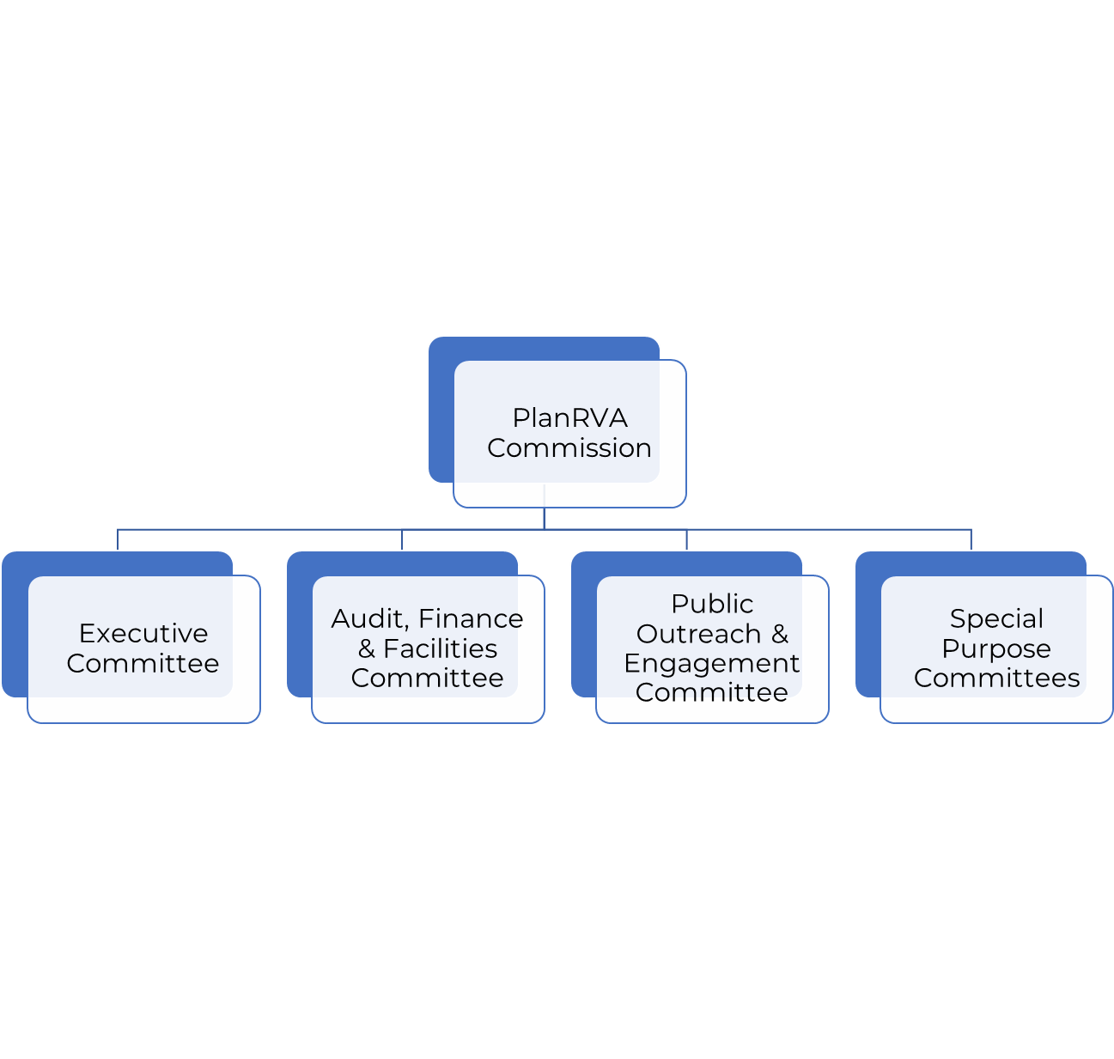
PlanRVA Committee Structure
Notes:
20

Slide 24
Data, Res & Tech
Administration & Finance
CVTA
EMACV
FOLAR
RRTPO
Member Localities
Peer PDCs
State/Federal Agencies
Regional Indicators
Data & Analysis
Community Partner & Public Outreach
Financial Management
Administration & Contracts
REME
Long Range Planning
Financial Programming
Regional Strategic Plan
Partner Orgs
Transportation
Emergency Management
Resiliency
Environment
Member Locality & Commissioner Engagement
Community Relations
Community Development
Housing
Economic Development
Local Technical Assistance
Project Management

Slide 25

Commissioner Responsibilities
Ensure Financial Integrity
Set Policies and Priorities
Nurture a Vision
Notes:
Nurture a Vision
Guiding “relevancy”
Building and Nurturing Relationships
Ensure Financial Integrity
Revenue Strategies
Identifying Efficiencies/ Expense Management
Monitoring Financial Management & Compliance
Set Policies and Priorities
Strategic Direction to Executive Director
Assess Performance
. .
21

Slide 26

Opportunities to Get Involved
  Newsletter Signup
  Blog and Social Media
  Meeting Attendance, Committee Membership
  Local Champion/Ambassador
  Leadership Succession
  Peer-to-peer networking
  State/National Associations
Notes:
Orientation
Public Outreach & Engagement Committee hosts sessions twice/annually
Communications
Commissioner Profile Form (to be developed)
Want to collect Communication Preferences and contact info, professional information (bio, etc), programmatic interests, birthdays, and other relevant/helpful background information
Newsletter Signup
Blog and Social Media
Participation
Attendance
Local Champion/Regional Ambassador
Committee Membership
Programmatic Advisor
Liaisons
Leadership Succession
Ongoing Development
Peer-to-peer networking
Training and Programs
State/National Associations
22

Slide 27

Important Things to Know
      We are NOT a state agency
      Accountable to the General Assembly through reporting only
      Funding Mix is Diversifying
      Commission adopts annual Work Program & Budget Priorities
      Organizational Key Imperatives advance 2019 Strategic Planning Framework
Notes:
Growing Existing Program Areas
- Diversifying Revenue Streams
Priority on Local Technical Assistance
Investment in developing service areas:
- Community Engagement
- Data, Research & Analysis
Staff Capacity and Development
23

Slide 28

Helpful Resources
National Association of Development Organizations
National Association of Regional Councils
Virginia Association of Planning District Commissions
Virginia Association of Counties
Virginia Municipal League
Notes:
NADO
Leadership and governance trainings from the National Association of Development Organizations
NADO Resource Toolkit (see page 68)
NARC
VAPDC
VACo
VML
24

Slide 29
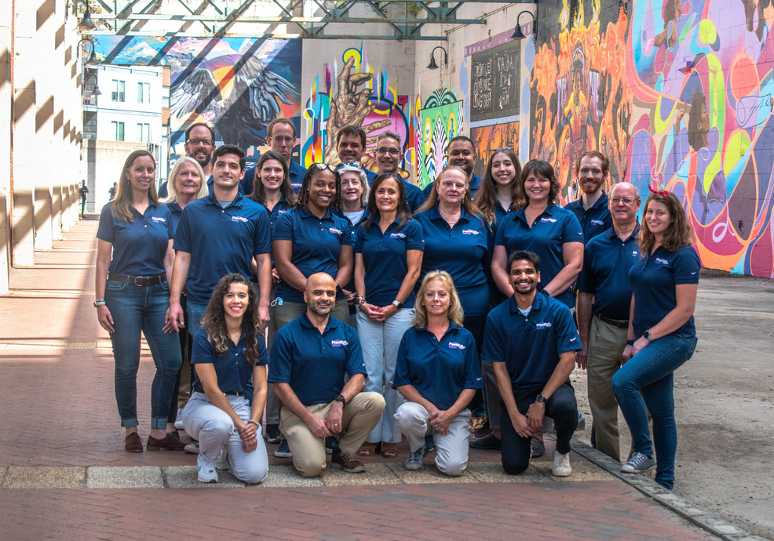



Thank You For Your Time!
Martha Shickle, Executive Director
804.924.7030 (o)
540.336.1323 (m)
martha@PlanRVA.org
Stay connected:
www.planrva.org
Notes:
25

