Slide 1
RRTPO Policy Board Meeting
September 5, 2024
Item B.-1.
2050 LRTP Update
Scope of Work, Schedule and Advisory Working Group

Slide 2
What is the LRTP ?
The Long-Range Transportation Plan (LRTP) is a significant decision tool and a dynamic living document that projects regionally significant transportation needs in the Richmond region over 20 years and beyond.
Develops a vision and goals for the Richmond region but also reflects the application of those programmatic transportation goals to project prioritization.
Regionally significant transportation project needs to be in the LRTP to get Federal or State funding.
The LRTP must be updated at least every five years to remain consistent with existing conditions, and to re-evaluate proposed plans, programs, and projects.
The 2050 LRTP update is due by October 2026. ConnectRVA 2045 expires at midnight on October 4, 2026.
Code of Federal Regulation § 450.324
Development and content of the Metropolitan Transportation Plan
Code of Virginia § 33.2-3201
Transportation planning duties and responsibilities of Metropolitan Planning Organizations

Slide 3
End Users & Implementers
The Users of the Richmond Region’s Transportation Systems
Residents of the Richmond region
People passing through the Richmond region
Goods/Freight moving within orpassing through the Richmond region
Implementers of the Transportation Projects
Localities
VDOT/DRPT
GRTC
CVTA

Slide 4
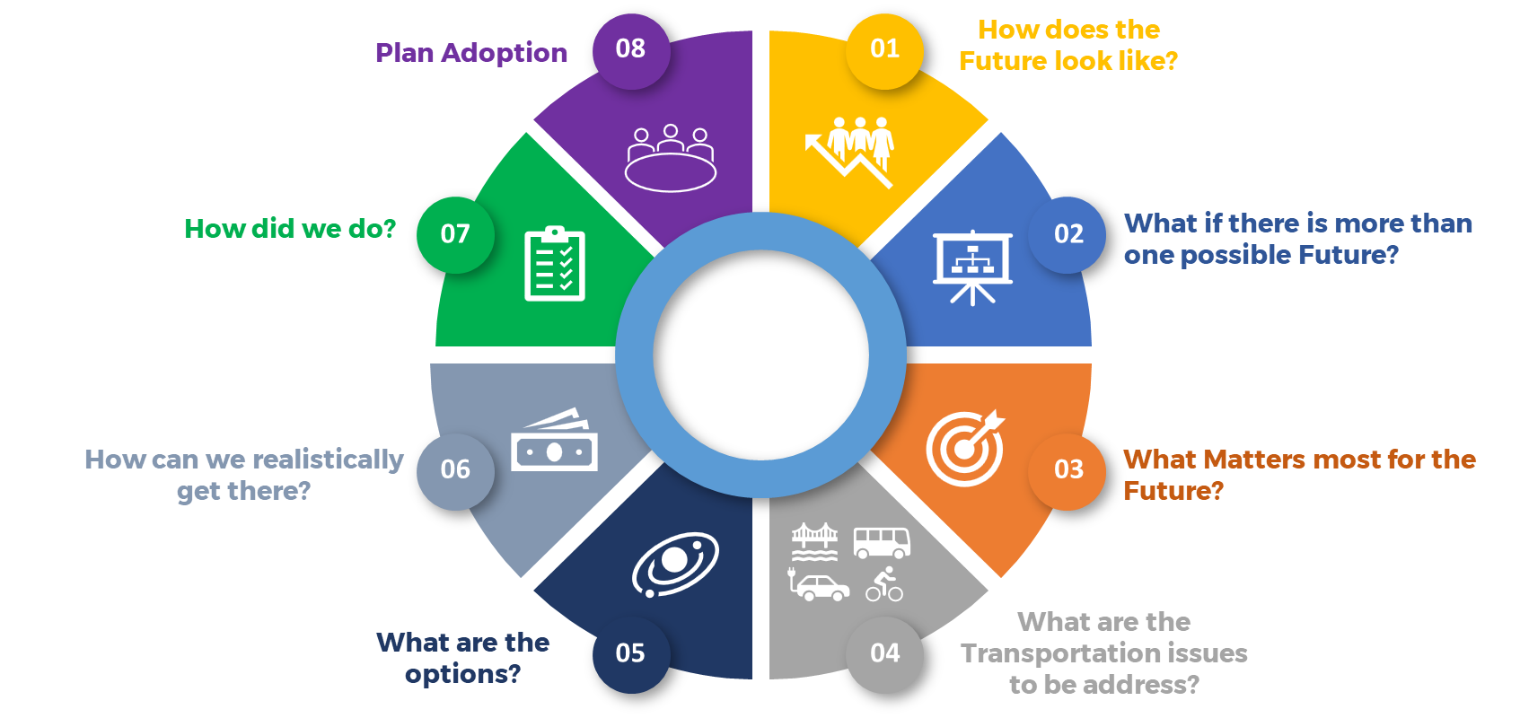
2050 LRTP – Scope of Work
2050 LRTP
PROCESS FLOW
Formal Public Review

Slide 5
Advisory Working Group
The LRTP Advisory Working Group (LRTP-AWG)
Provide input and oversight in the development of the 2050 LRTP.
Autonomy to make decisions guiding the process and outcomes.
Composition - locality representatives; regional, state and federal transportation partners; representatives from special interest groups.
All TAC members (or designee) + a few CTAC members (at-large organizations) + Others
15-18 meetings over the course of two years (in-person and Virtual)

Slide 6
Action Requested
RESOLVED, that the Richmond Regional Transportation Planning Organization (RRTPO) Policy Board approves the 2050 Long-Range Transportation Plan (LRTP) scope of work and schedule as presented to serve as the general guidance to staff and the LRTP Advisory Working Group.
FURTHER RESOLVED, that RRTPO Policy Board approves the Long-Range Transportation Plan Advisory Working Group (LRTP-AWG) be established for the purpose of providing input and oversight in the development of the 2050 Long-Range Transportation Plan.

Slide 7
Thank You!
Sulabh Aryal, AICP
Transportation Planning Manager
saryal@planrva.org
424 Hull St Rd Suite 300
Richmond, VA 23224
Phone: (804) 323-2033
www.planrva.org

