Slide 1
Emergency Management Alliance of Central Virginia
Steven Herring, EMACV Chair
Darshan Parikh, EMACV Vice Chair

Slide 2
Growing Capabilities
Takeaways
Priorities
Notes:
Decrease in grants and local budget
Thank Martha and Crater for support

Slide 3
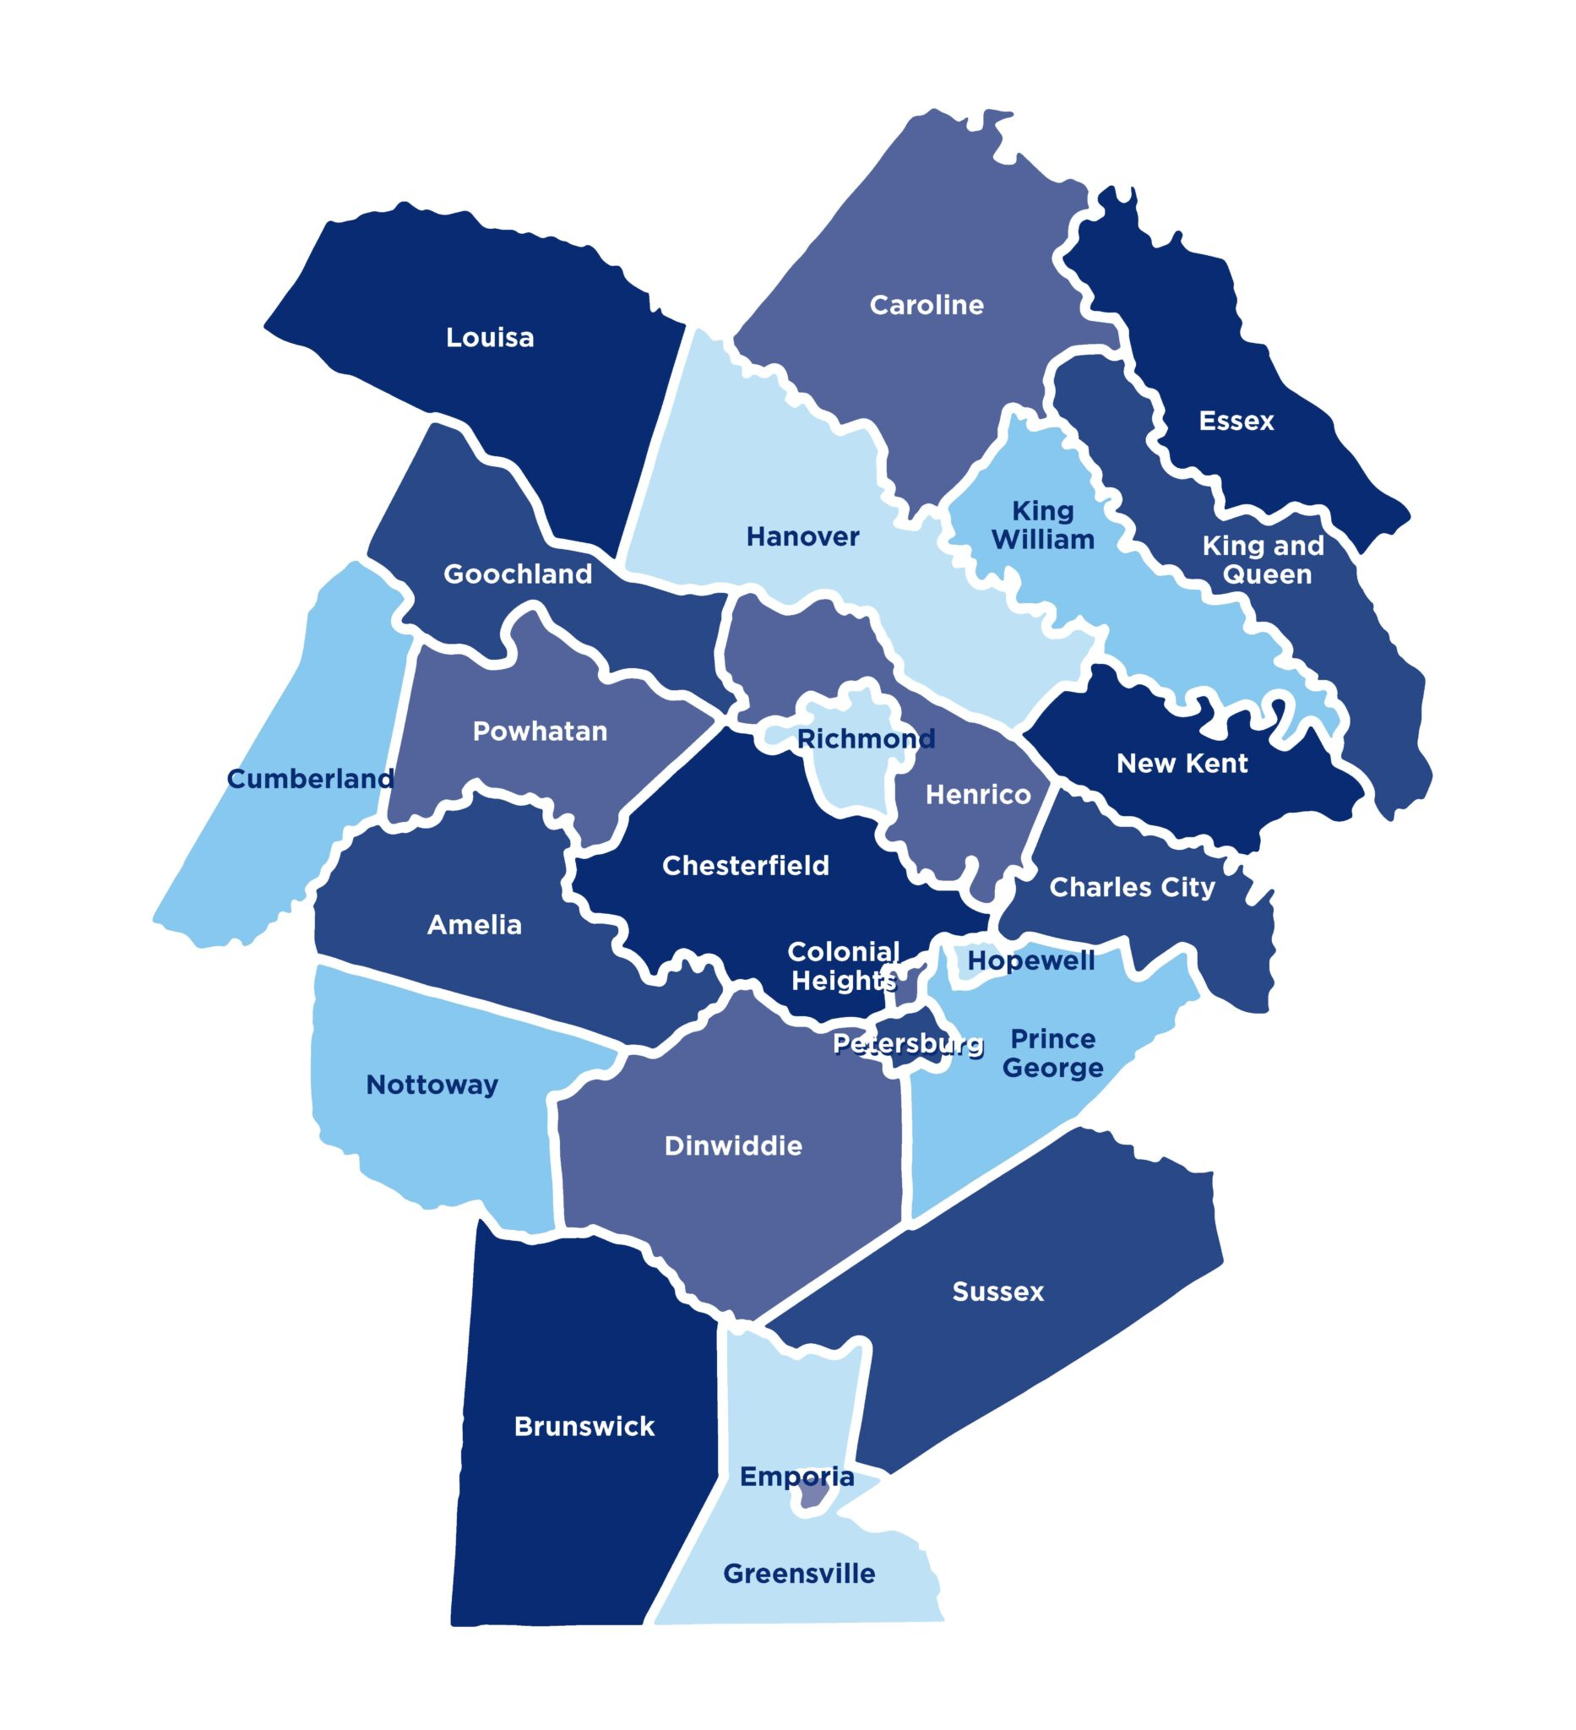

Slide 4
2024 EMACV Priorities

Slide 5
Meeting EMACV in 2024
Brand new leadership team consisting of professionals from state, local, and private sectors.
Virginia Department of Health
City of Richmond
University of Richmond
Goochland County
King William County
Charles City County
Chesterfield County
City of Colonial
City of Hopewell
BHE GT&S

Slide 6
Priorities
Secure preparedness funding streams due to a reduction in federal SHSP grants.
Enhance collaboration and engagement with Alliance stakeholders.
Crater and Southside PDCs
Virginia Department of Emergency Management
Hampton Roads and Northern Virginia emergency management alliances
Enhance community resilience through Alliance programs.

Slide 7
Growing Capabilities

Slide 8
Mass Care & Human Services Committee
2024 Mass Care Symposium
Shelter Video Training Series
Equipment Purchases

Slide 9
Public Outreach Committee
Partnership with the Richmond Flying Squirrels.
Preparedness bags and supplies available to Alliance members for public outreach events.

Slide 10
Regional Community Emergency Response Team (CERT) Committee
2023 CERT Forum & Skills Rodeo
State CERT Training
Regional CERT Support

Slide 11
Planning
2023 Business Recovery Workshop
2025 Alliance Strategic Plan

Slide 12
Training & Exercise Committee
Exercise Support Unit – 1
ICS & Additional Classes
Training Support

Slide 13
Cyber
Mitigation through Community Preparedness
Relationships with stakeholders
Supporting PlanRVA CIKR grant submission
Richmond-Crater HMP
Power/Utilities
Climate

Slide 14
Takeaways

Slide 15
Takeaways
Connect with your local emergency manager to discuss areas where a reduction in SHSP funds could impact readiness.
Help the Alliance identify funding sources to fill the gap and meet future needs.
Continue being an involved stakeholder in the Alliance.

Slide 16
Thank you!
Steven Herring, EMACV Chair
Email: steven.herring@vdh.virginia.gov
Phone: (804) 895-5142
Darshan Parikh, EMACV Vice Chair
Email: darshan.parikh@bhegts.com
Phone: (804) 929-7219

